Slide 1



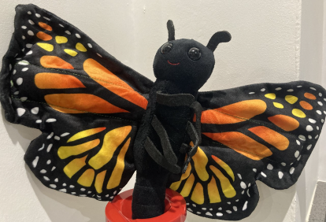
Personal, Social, Emotional Development
In our circle time, once a week, we will use SCARF (safety, caring, achievement, resilience and friendship) as part of a whole school approach to health and well-being.
We will be working on;
Talk about how to keep their bodies healthy and safe.
Name ways to stay safe around medicines.
Know how to stay safe in their home, classroom and outside.
Know age-appropriate ways to stay safe online.
Name adults in their lives and those in their community who keep them safe.
As well as explicitly teaching this area of learning we will also respond to spontaneous events within the classroom and use these as a teaching point and opportunity to model.
Physical Development
We follow our specific school scheme and will be focussing on our first PE theme, ‘Dance’ – specifically moving forwards, backward and sideways, demonstrating two-dimensional shapes and some partner work. We will also be working on our listening and attention skills following instructions.
We will continue to strengthen our fine motor skills by using a wide range of equipment to make refined shapes, and continue to focus on our daily handwriting sessions this half term!
Communication and Language
We will be having planned opportunities for speaking and listening during circle times and through our ‘What did Bertie do?’ bag. The children will have the opportunity to take Bertie home for the weekend throughout the year!

Slide 2

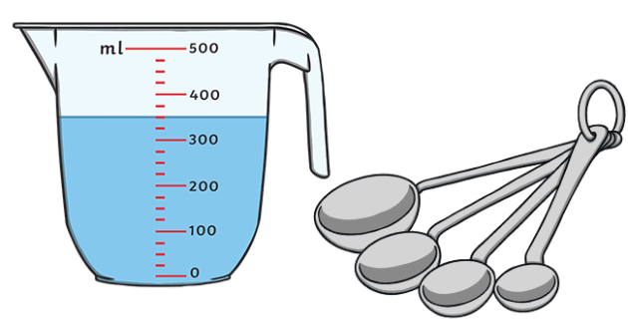
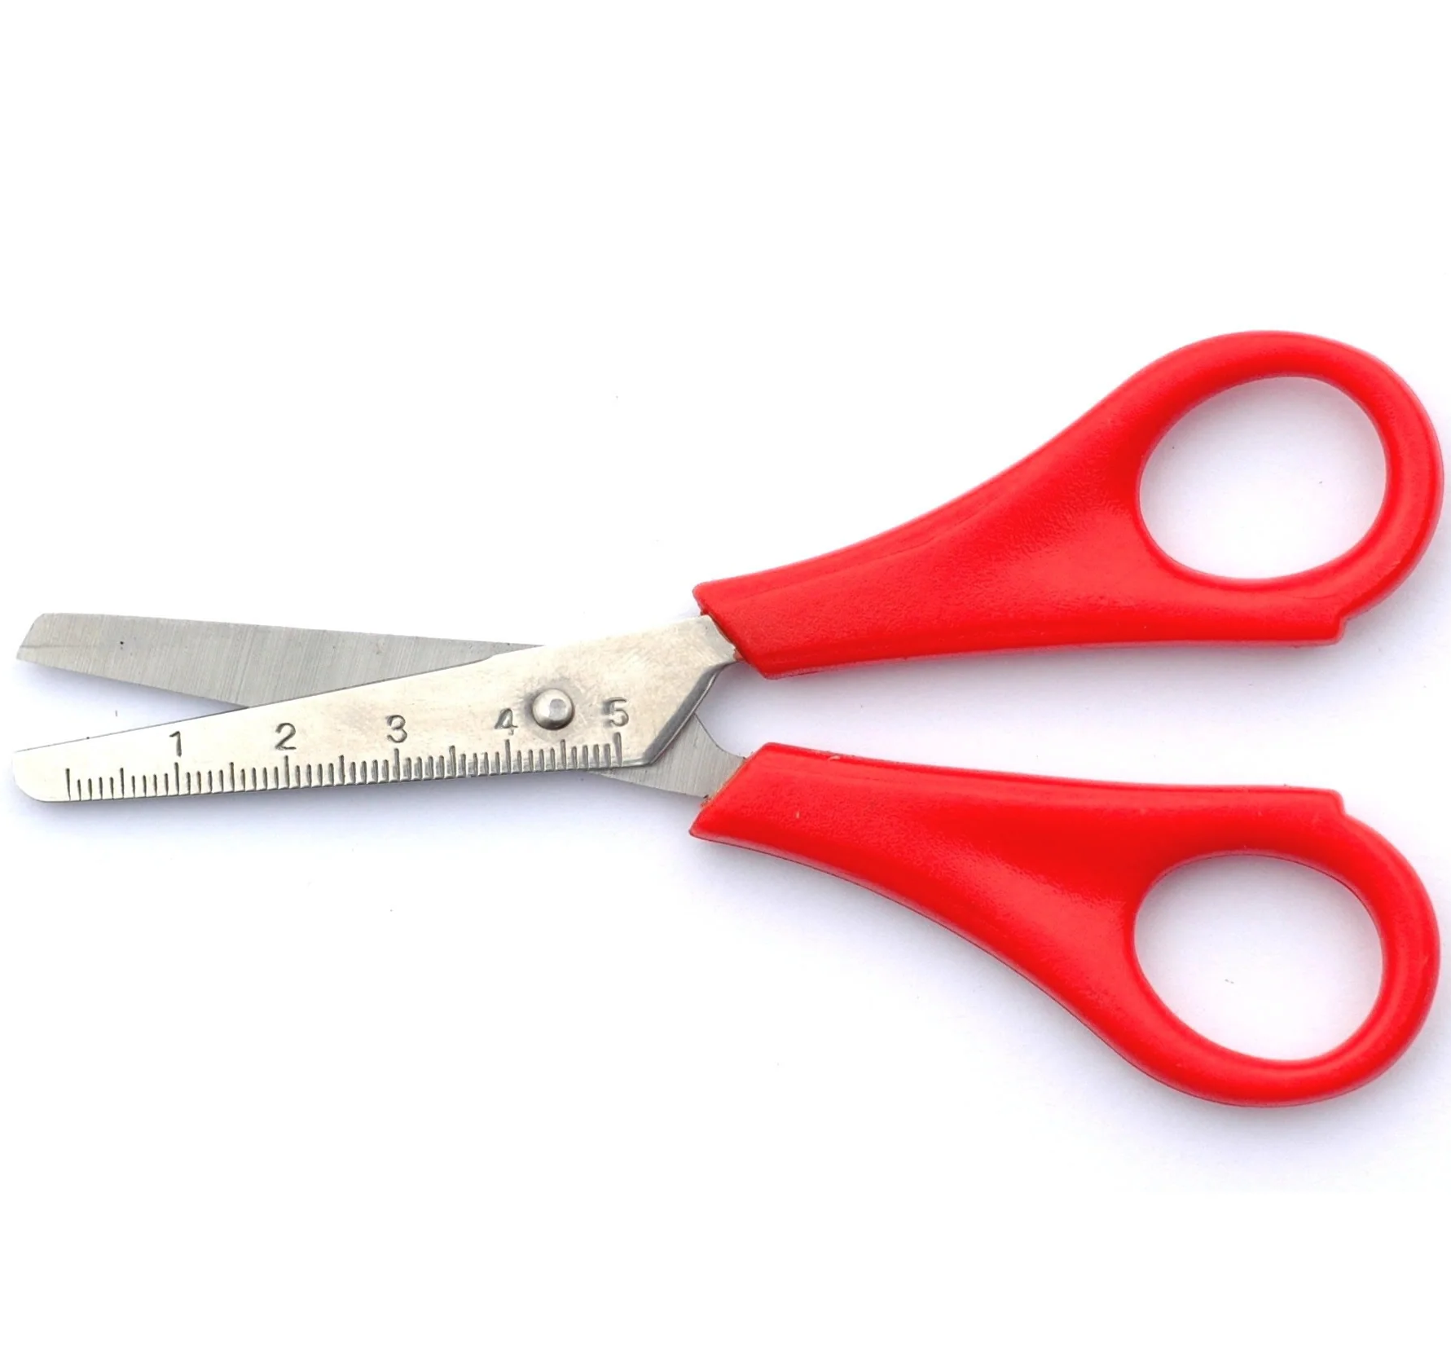
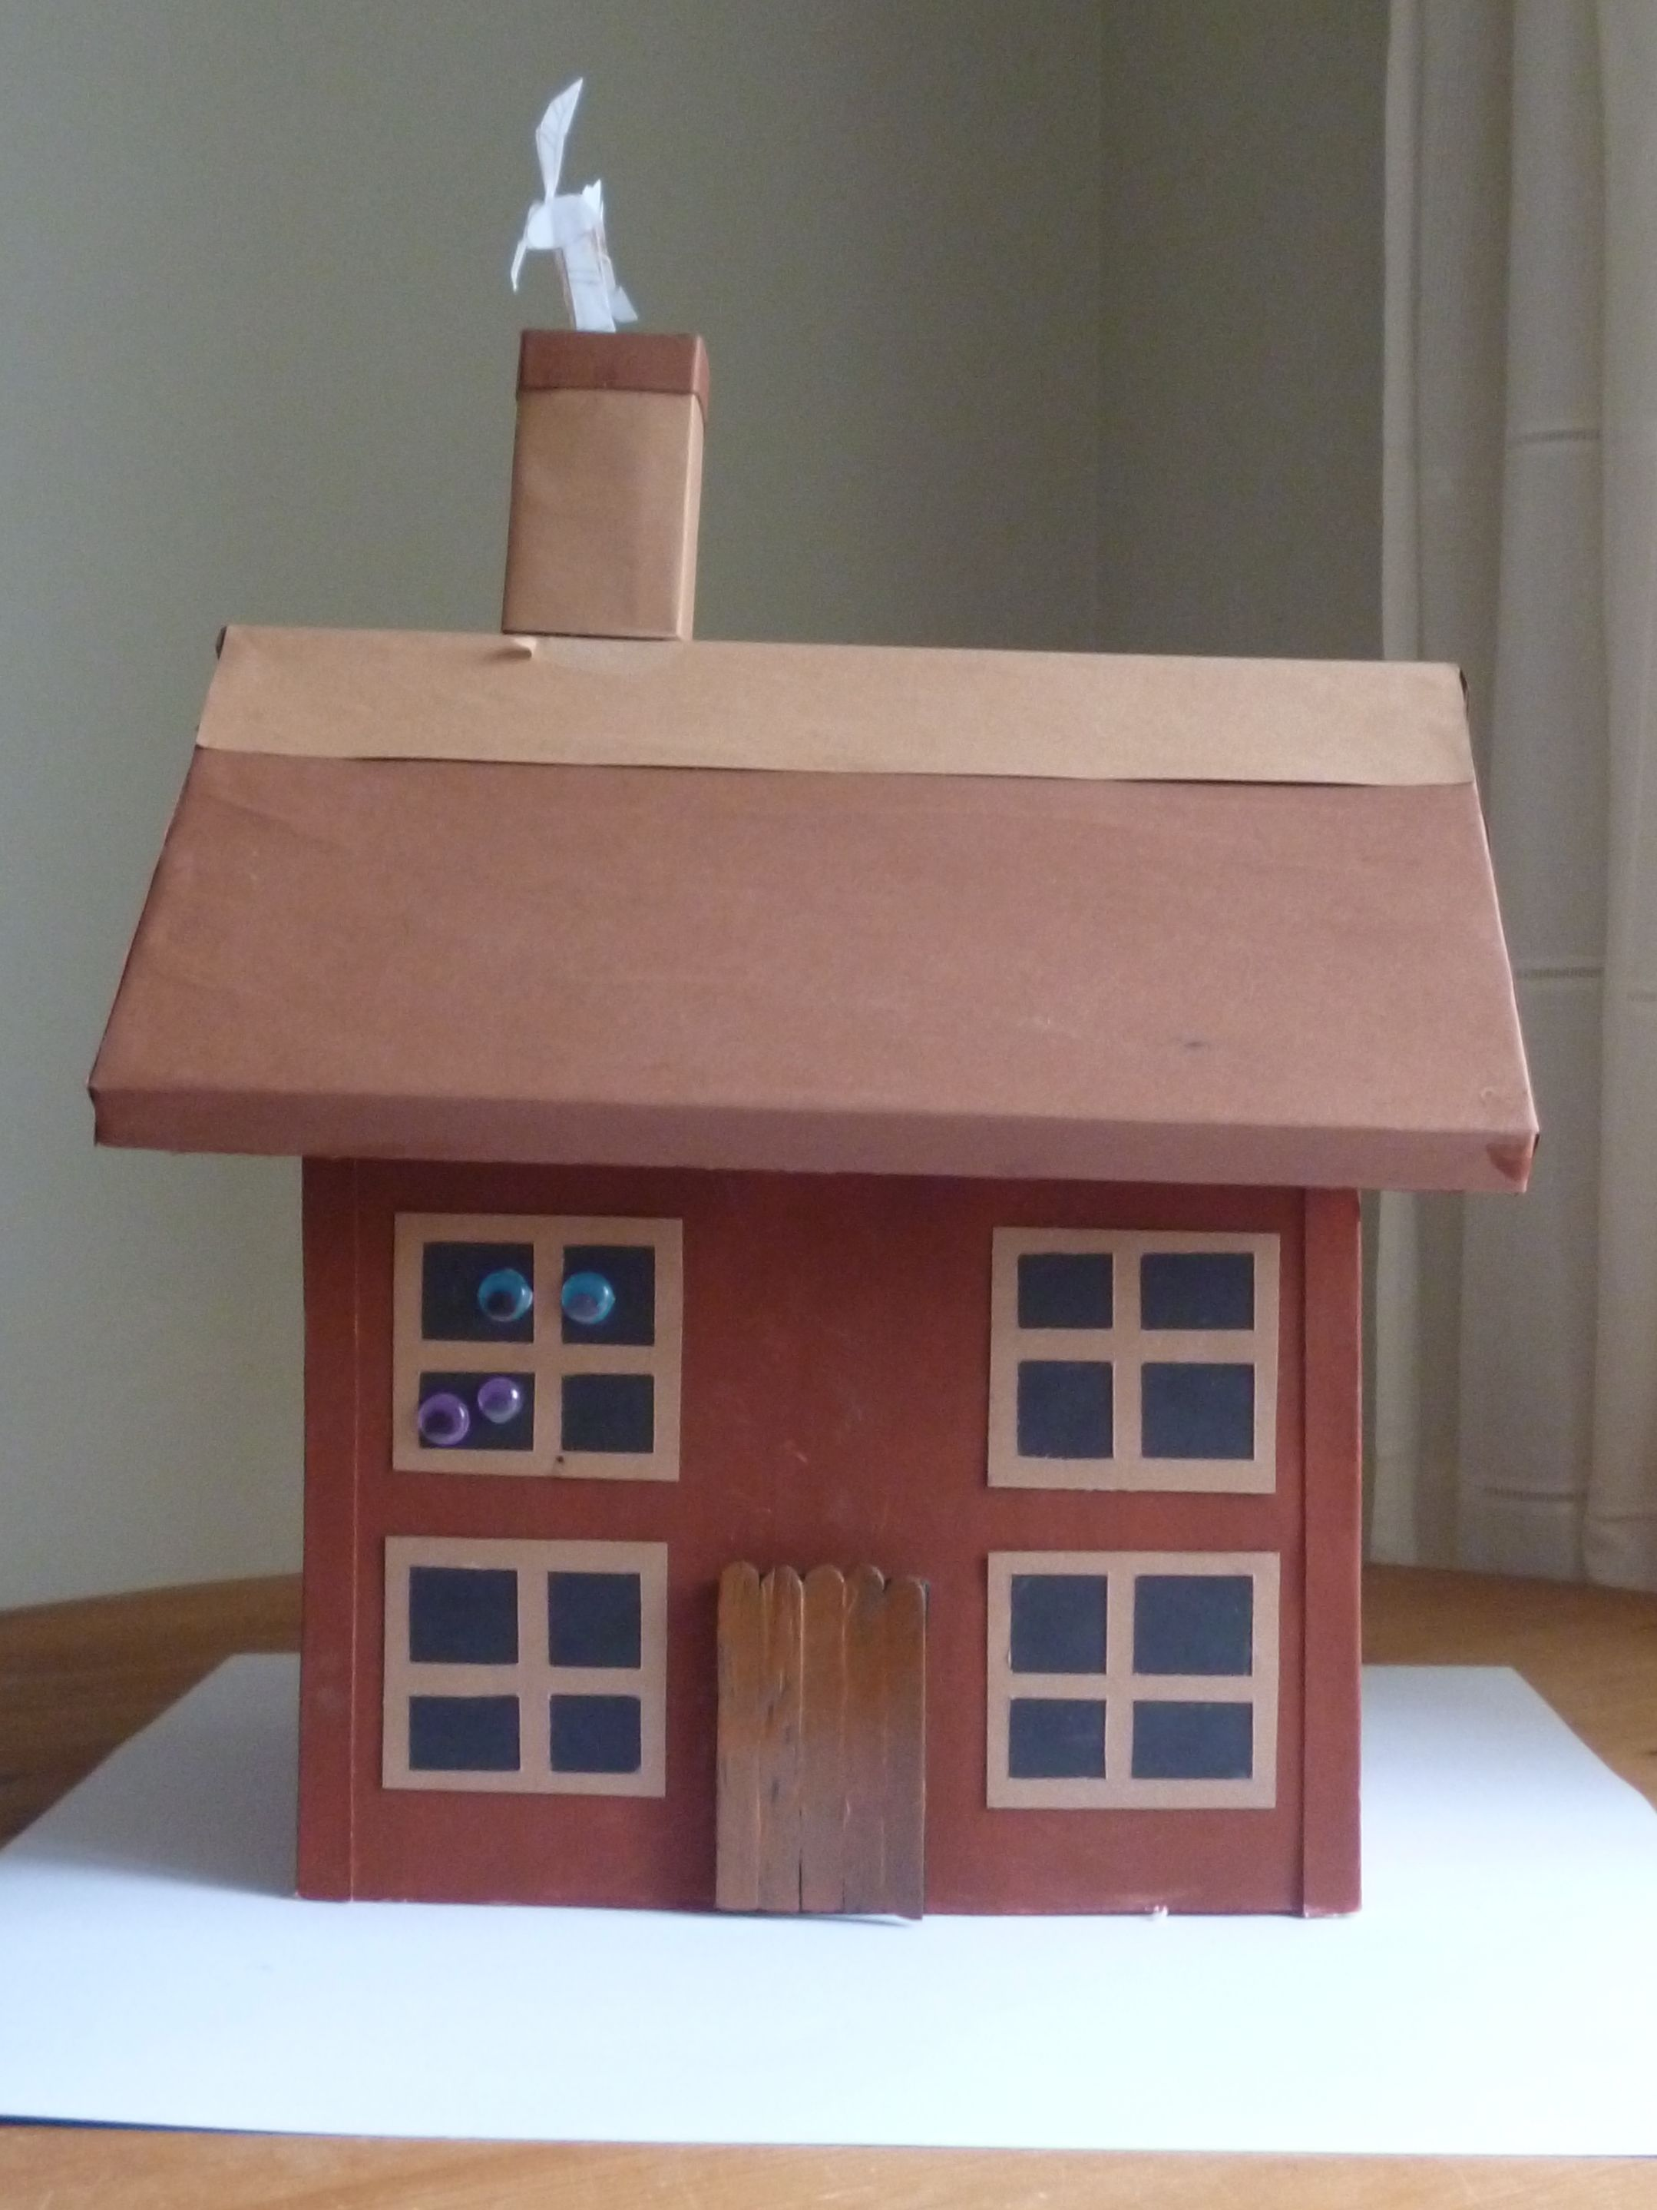
Literacy
Talk For Writing (T4W) key text: The Little Red Hen
We will put our story map up on the wall so the we can access retelling it at any point throughout the day.
We will be discussing the stories mains points, such as the characters, setting, the problem and the solution.
We will have lots of opportunities for writing and mark making. We will be focussing on being able to write CVC words and simple captions.
Maths
We will follow our maths scheme in F2 by following White Rose. This half term we will be focussing on;
Recognising numerals 0-5 and subitising and representing these numerals
One more/less.
Exploring and comparing capacity
Representing 6/7/8 and matching quantities.
Odd and Even
Doubling
Understanding the World
We have an exciting class calendar that we will be adding different events, weather and key dates on. This will help the children talk about the past and future and also see seasonal changes clearly too!
We will be looking at our topic ‘Once Upon a Time’. We will be exploring different skills through different Fairy Tale stories such as ‘Three Little Pigs’ ‘ Billy’s Goats Gruff’. We will completing fun projects such as, making our own junk model houses, and even some baking!
Expressive Arts and Design
We will, as always be reminding the children about ‘Tool Safety’ and how we use and walk around with different tools safely.
We will be focussing on making some independent choices about the resources we use to create our work and talk about our choices. We will be using different textures in creations and will combine medias for our determined outcome.
All these skills will help support the children when they have to design and make their own junk model houses and design the decoration to go onto their gingerbread!

